Slide 1

THINKING
Concepts, Elements of Thinking, and Creative Thinking
Presented by:
- Munu pokharel

Slide 2

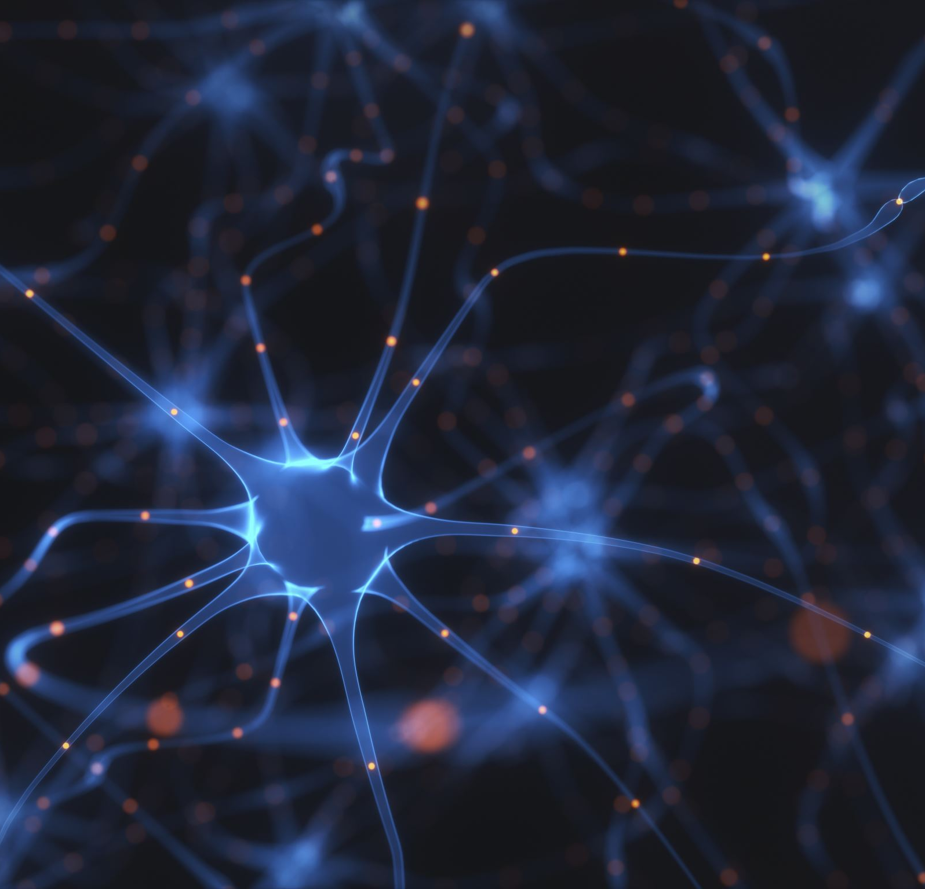
Introduction to Thinking
Thinking is a fundamental cognitive process that enables humans to understand and navigate the world.
It enables individuals to understand, analyze, solve problems, and make decisions.
Thinking helps people adapt to their environment and achieve goals.
It is closely related to perception, memory, intelligence and learning.

Slide 3

What is Thinking?
"Thinking is a mental activity involving the manipulation of information.“
It is the central mental process through which people organize information, develop abstract concepts, and solve problems.

Slide 4
Elements of Thinking
The main elements of thinking are as follows:-
Concepts:
This may be understood as mental categories used to group similar objects, events, or ideas.
They make thinking and communication more efficient by allowing us to group many individual items under one common label.
For example: For example, “fruit” includes apples and bananas, “animal” includes dogs and birds, and “student” refers to a person who is learning in a school or institution.

Slide 5
2. Images:
These are the mental representations of objects or events.
They allow us to visualize things even when they are not physically present.
For example: Imagining Mt. Everest without seeing it.
3. Symbols:
These represent ideas, objects or events.
Words, numbers, and signs are common symbols.
For example: “ +” means addition while the national flag represents a country

Slide 6
4. Language:
Language is a system of communication using words and symbols.
It plays a vital role in thinking and reasoning.
Functions:
Express thoughts
Communicate ideas
5. Reasoning:
Reasoning is the process of drawing conclusions from available information.
For example: All humans are mortal. Therefore, Ram is a mortal.

Slide 7
6. Problem Solving:
It may be defined as the process of finding solutions to difficulties or challenges.
Steps:
Identify the problem
Analyze the problem
Generate solutions
Choose the best solution
Evaluate outcome
For example: Preparing a study schedule to improve exam performance.
7. Decision Making:
It is selecting the best alternative among available options.
For example: Choosing a career after higher secondary education.

Slide 8

What is Creative Thinking?
Creative thinking is characterized by divergent thinking, which produces multiple possible solutions to a problem.
It goes beyond traditional, habit-bound thinking patterns.
It involves restructuring how we view a problem.

Slide 9

Core Characteristics
Originality
Ability to produce unique and innovative ideas.
Fluency
Generation of many ideas in a short amount of time.
Flexibility
Ability to view problems from different perspectives.
Elaboration
Ability to develop and improve ideas by adding details.
Imagination
Creation of mental possibilities.
Curiosity
Desire to learn, explore, and question

Slide 10
The 4 Stages of Creative Thinking
Stage 1- Preparation:
Refers to gathering of information and understanding the problem.
Identifying the facts and possible approaches
Stage 2- Incubation:
The problem is set aside temporarily.
The unconscious mind continues processing the information.

Slide 11

Stage 3- Illumination:
This refers to the sudden appearance of a new idea or solution.
It is often referred to as the “aha” moment.
Stage 4- Verification:
This is the stage wherein the idea is tested and evaluated.
Determining whether the solution is practical and useful.

Slide 12
Importance of Creative Thinking
Enhances problem-solving ability
Encourages continuous innovation
Promotes rapid adaptability
Increases selfconfidence
Improves professional productivity

Slide 13
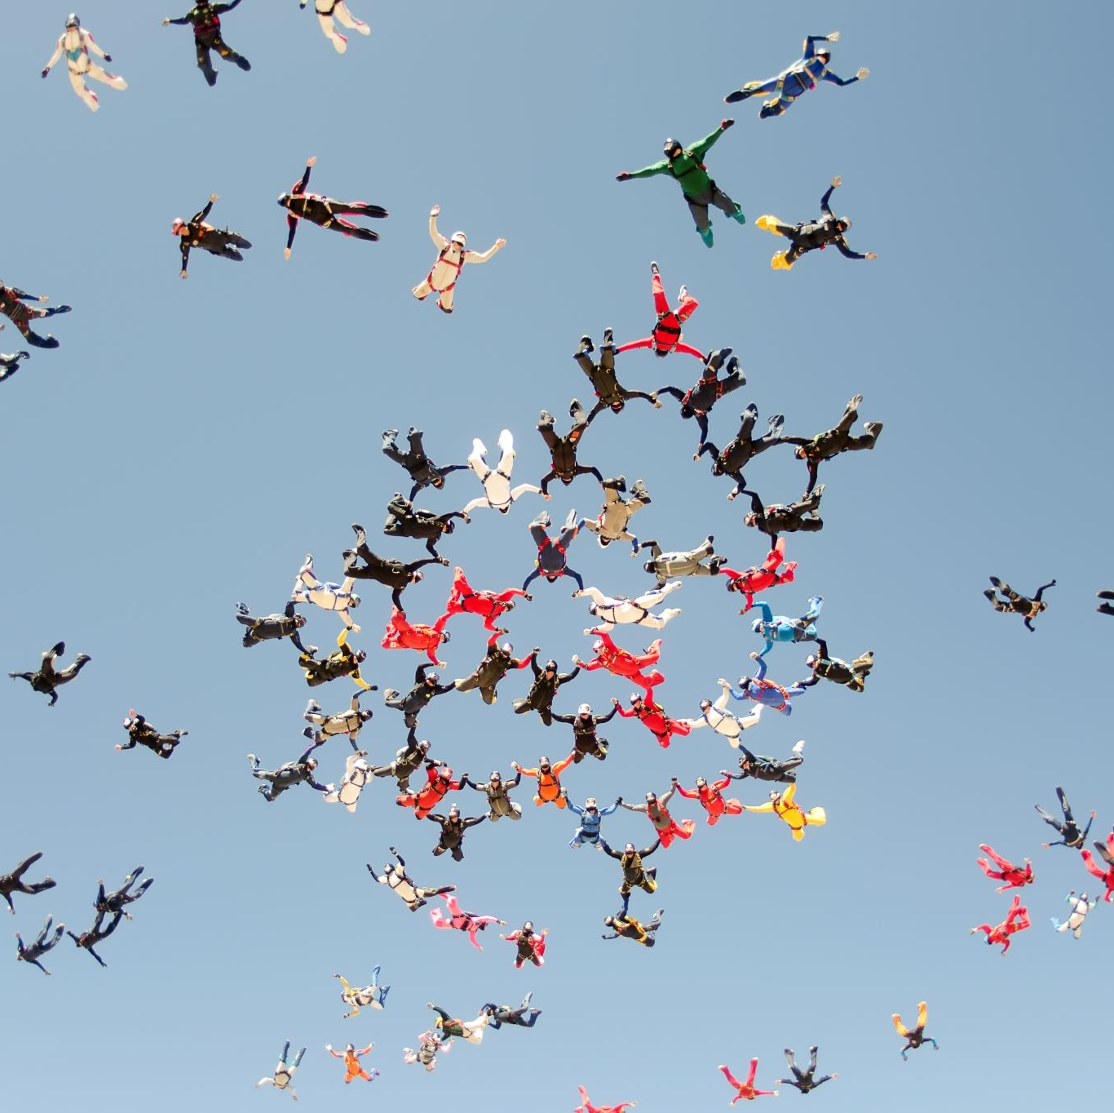
Conclusion
Thinking is a core cognitive process in psychology.
It involves concepts, images, symbols, language, reasoning, problem solving and decision making.
Effective thinking contributes to personal, educational and professional success.
Creative thinking is an essential cognitive ability that involves the generation of original and useful ideas.

Slide 14
References
1. Feldman, R. S. (2019). Understanding Psychology.
2. Morgan, C. T., King, R. A., Weisz, J. R., & Schopler, J. Introduction to Psychology.
3. Sternberg, R. J. Cognitive Psychology.
4. Baron, R. A. Psychology.
5. Coon, D., & Mitterer, J. O. Introduction to Psychology.
6. Guilford, J. P. (1967). The Nature of Human Intelligence.
7. Wallas, G. (1926). The Art of Thought.

