Slide 1
IHK Fast Track Connect update mockup

Slide 2
Scope of Work
Website UI Update
  Landing Page (page 6)
  YouTube Style Video Wall (page 9-12)
  Company Profile page (page 21-27)
  Company Directory/Eco System page and Filter (page 16, 18)
  GFT and other Programs (page 19, 20)
  News (page 21)
User roles Addition
  2 more new company roles can be added
  Existing company roles rename (optional)
Data Fields update
  Update UI To show selected fields (new or existing, at approx. 20-30)
  Original Data and data fields will be kept within the system but hidden
System functions
  User submit of YouTube Video link and PDF/PPT for Approval
  Admin review and approve/reject of submission
  Admin take down of YouTube Video Link/PDF/PPT
  News and Blogging
  Event creation and Registration
  GFT and other Program Application and Approval

Slide 3
Roles
System: Admin for IHK and FV to use and manage
Companies:
  Technology Companies
  3 existing Champions (rename needed)
  planning to add 2 more new roles
User:
  Anonymous (read only, 5 video browsing,
  Registered: fall into one of the Company role

Slide 4
YouTube and File Application and Review Process
Registration and Setup company
  1. Anonymous browse public content
  2. user self service registration with roles
  3. user self service create company
Upload and Apply for Video/File Publishing
  4. user (company) apply for Video Publish
  5. user (company) apply for Doc (PPT/PDF) Publish
Admin Review and Approval
  6. Admin Review the submission
  Either Approve or Reject
Admin can take down the published video/doc anytime

Slide 5
Event Management
1. Admin to create and manage event
2. Member to search and enroll
3. Admin to review registration (auto/manual)
4. System notification to enrolled members, Confirmation, reschedule/cancel/update, Thankyou
5. Member cancel registration

Slide 6
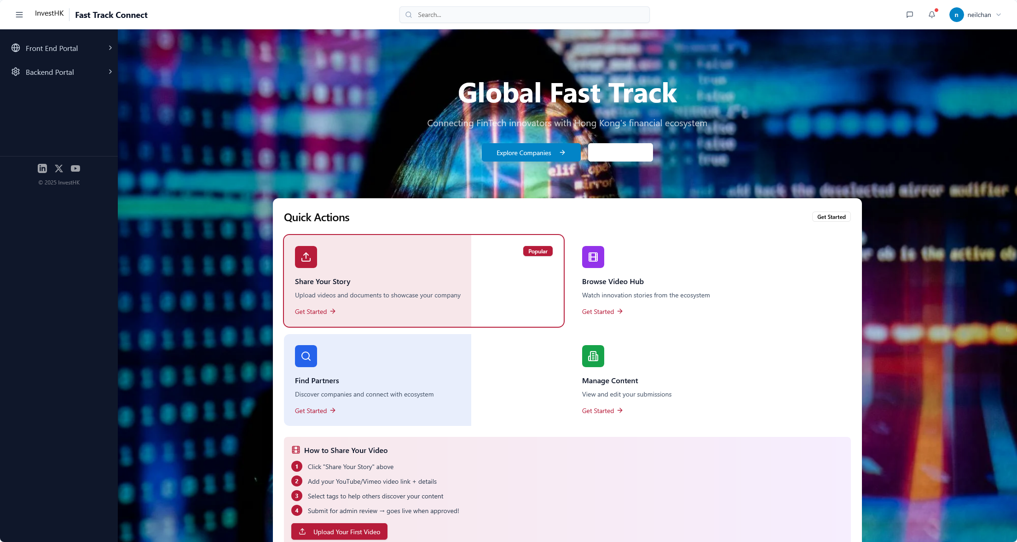
Redirect to news and insight page
Jump to Ecosystem Directory
Login:
Chose your interest tags
11 subsectors + startup (GFT)
+ Geography
What’s up?
Tokenization, AI and community news
Find an Investor / financial institution
Find new tech !
Upload/ Manage your profile
Upload 1)video and 2) publications
Only for backend allowed accounts
Jump to YouTube style Video wall
Jump to Company profile management

Slide 7
Tagging selection upon Registration
Option to enrich profile on first time registration or later in profile
3 sets of tag groups
1. 11 subsectors, (multi select options)
2. Startup (checkbox)
3. Geography (multi select options)
Remark, need tagging list (Deadline?) configurable
Tag Category
  Tags
Applicable to Company, video, doc etc.

Slide 8
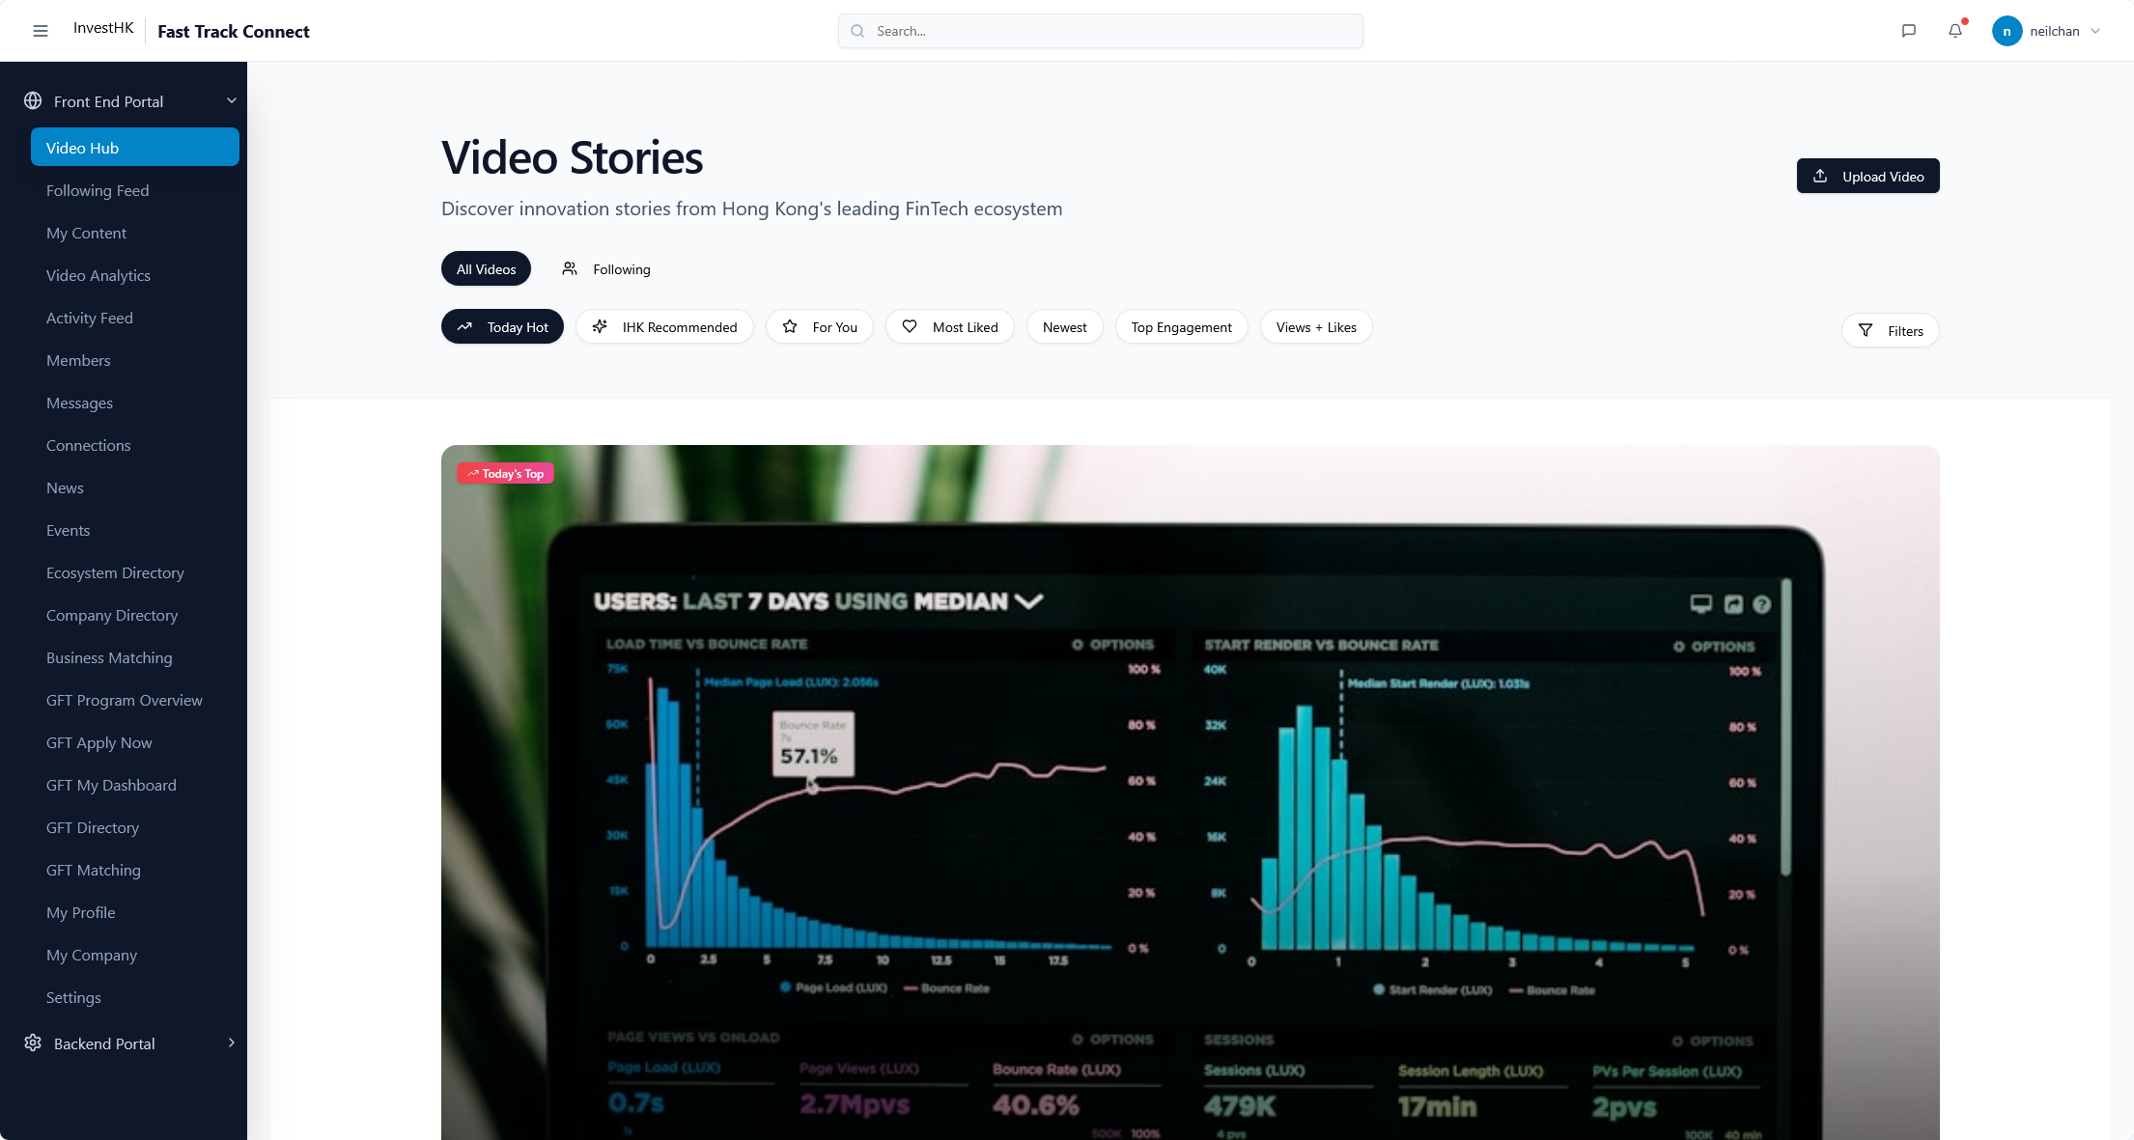
No need

Slide 9
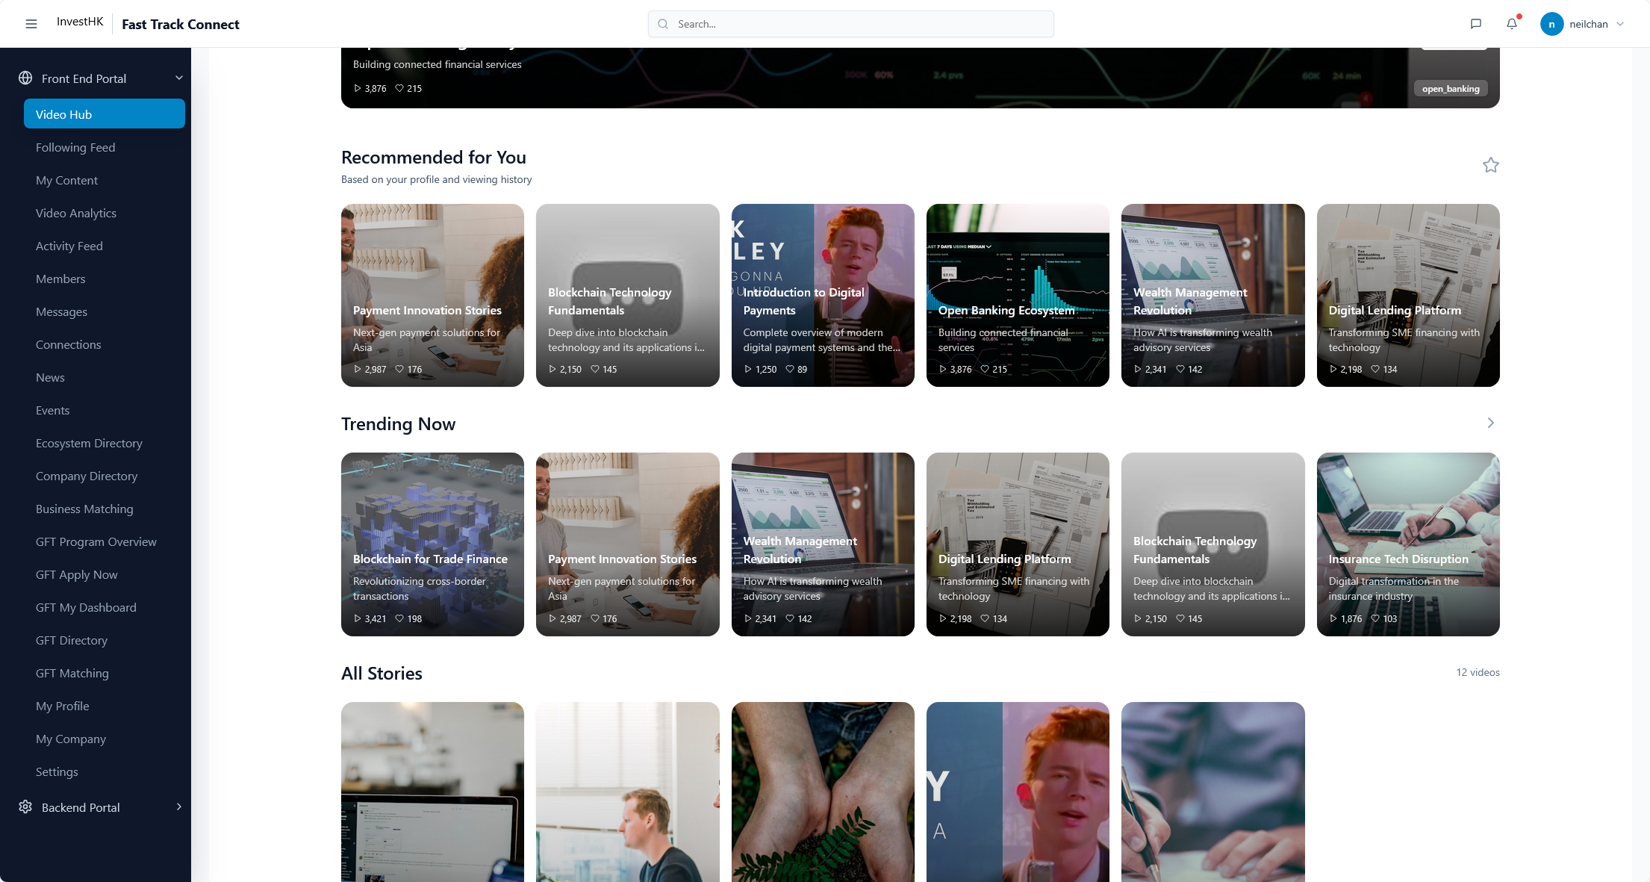
Subpage of the Video Wall, showing company video with tagging of
1. AI
2. On chain Security
3. Reg Tech
4. Tokenization assets
5. Platform
News
AI in Fintech
Publications
AI + Onchain Security, Reg tech
Tokenization assets + platforms

Slide 10
Subpage of the Video Wall, showing company video with tagging of
1. Payment
2. Digital Payment
3. Credit Technology
4. Capital Markets Technology
News
Payment and Digital payment
Publications
Credit technology
Capital markets technology

Slide 11
Subpage of the Video Wall, showing company video with tagging of
1. GFT Companies (new or Alumni)
News
Global Fast Track
Publications

Slide 12
Subpage of the Video Wall, showing company video with tagging of
1. HKSTP Sandbox
News
HKSTP Sandbox
Publications

Slide 13
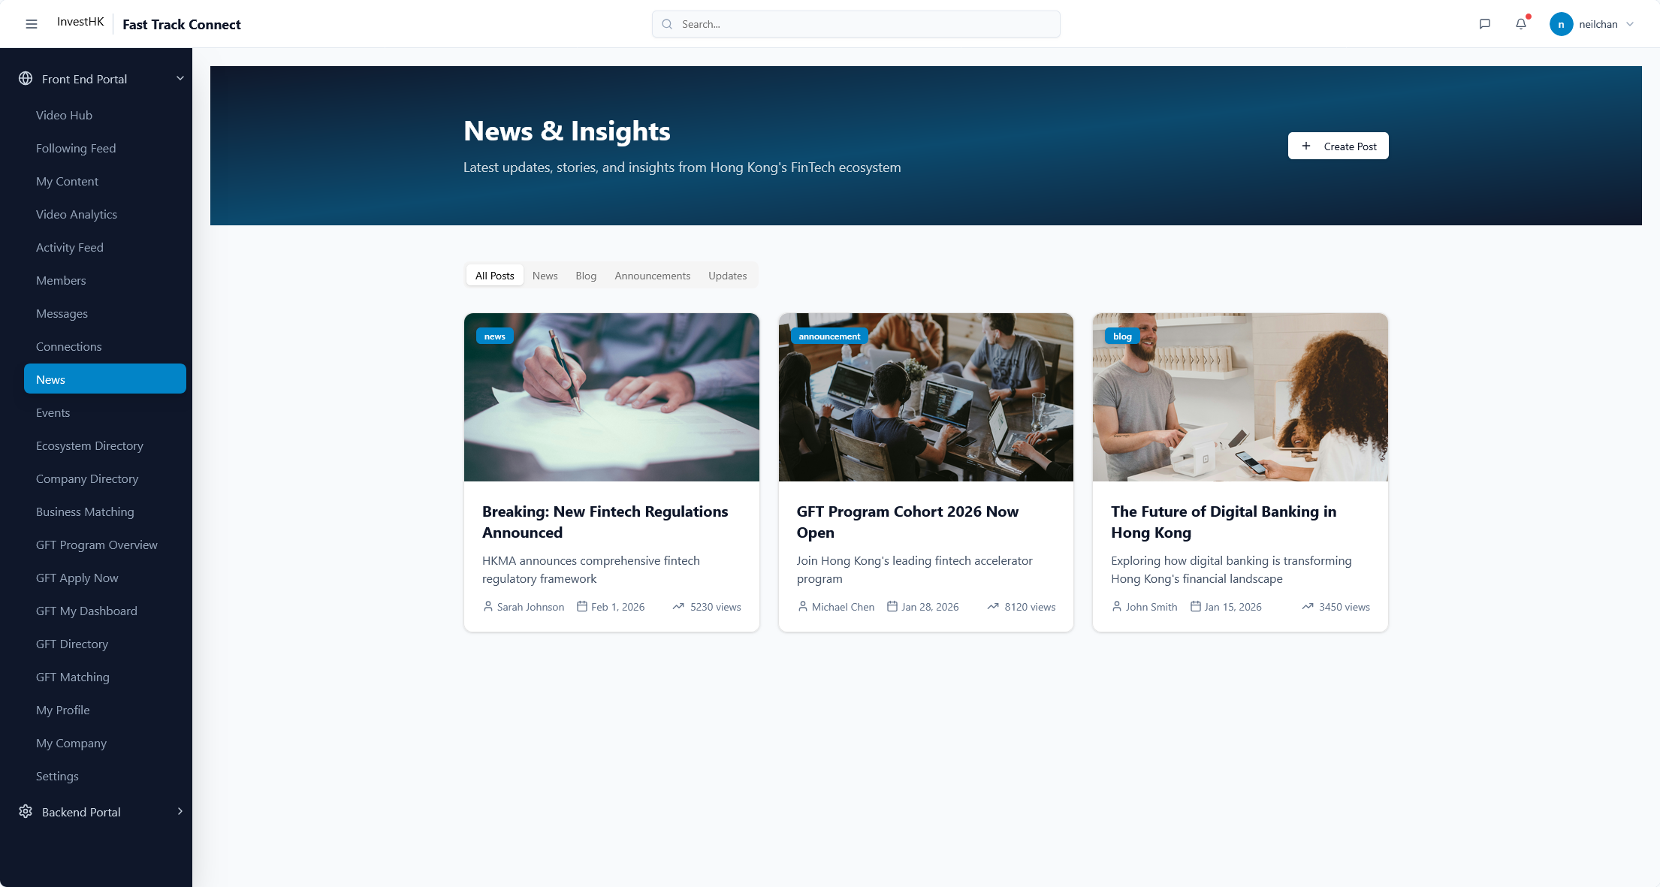

Slide 14
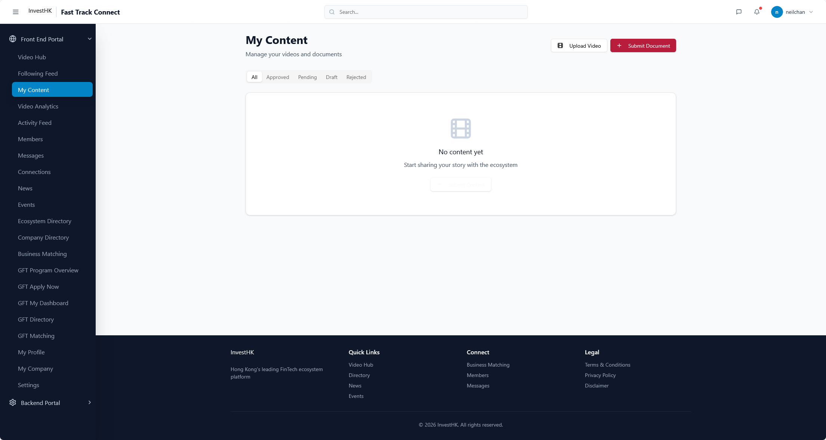

Slide 15


Slide 16
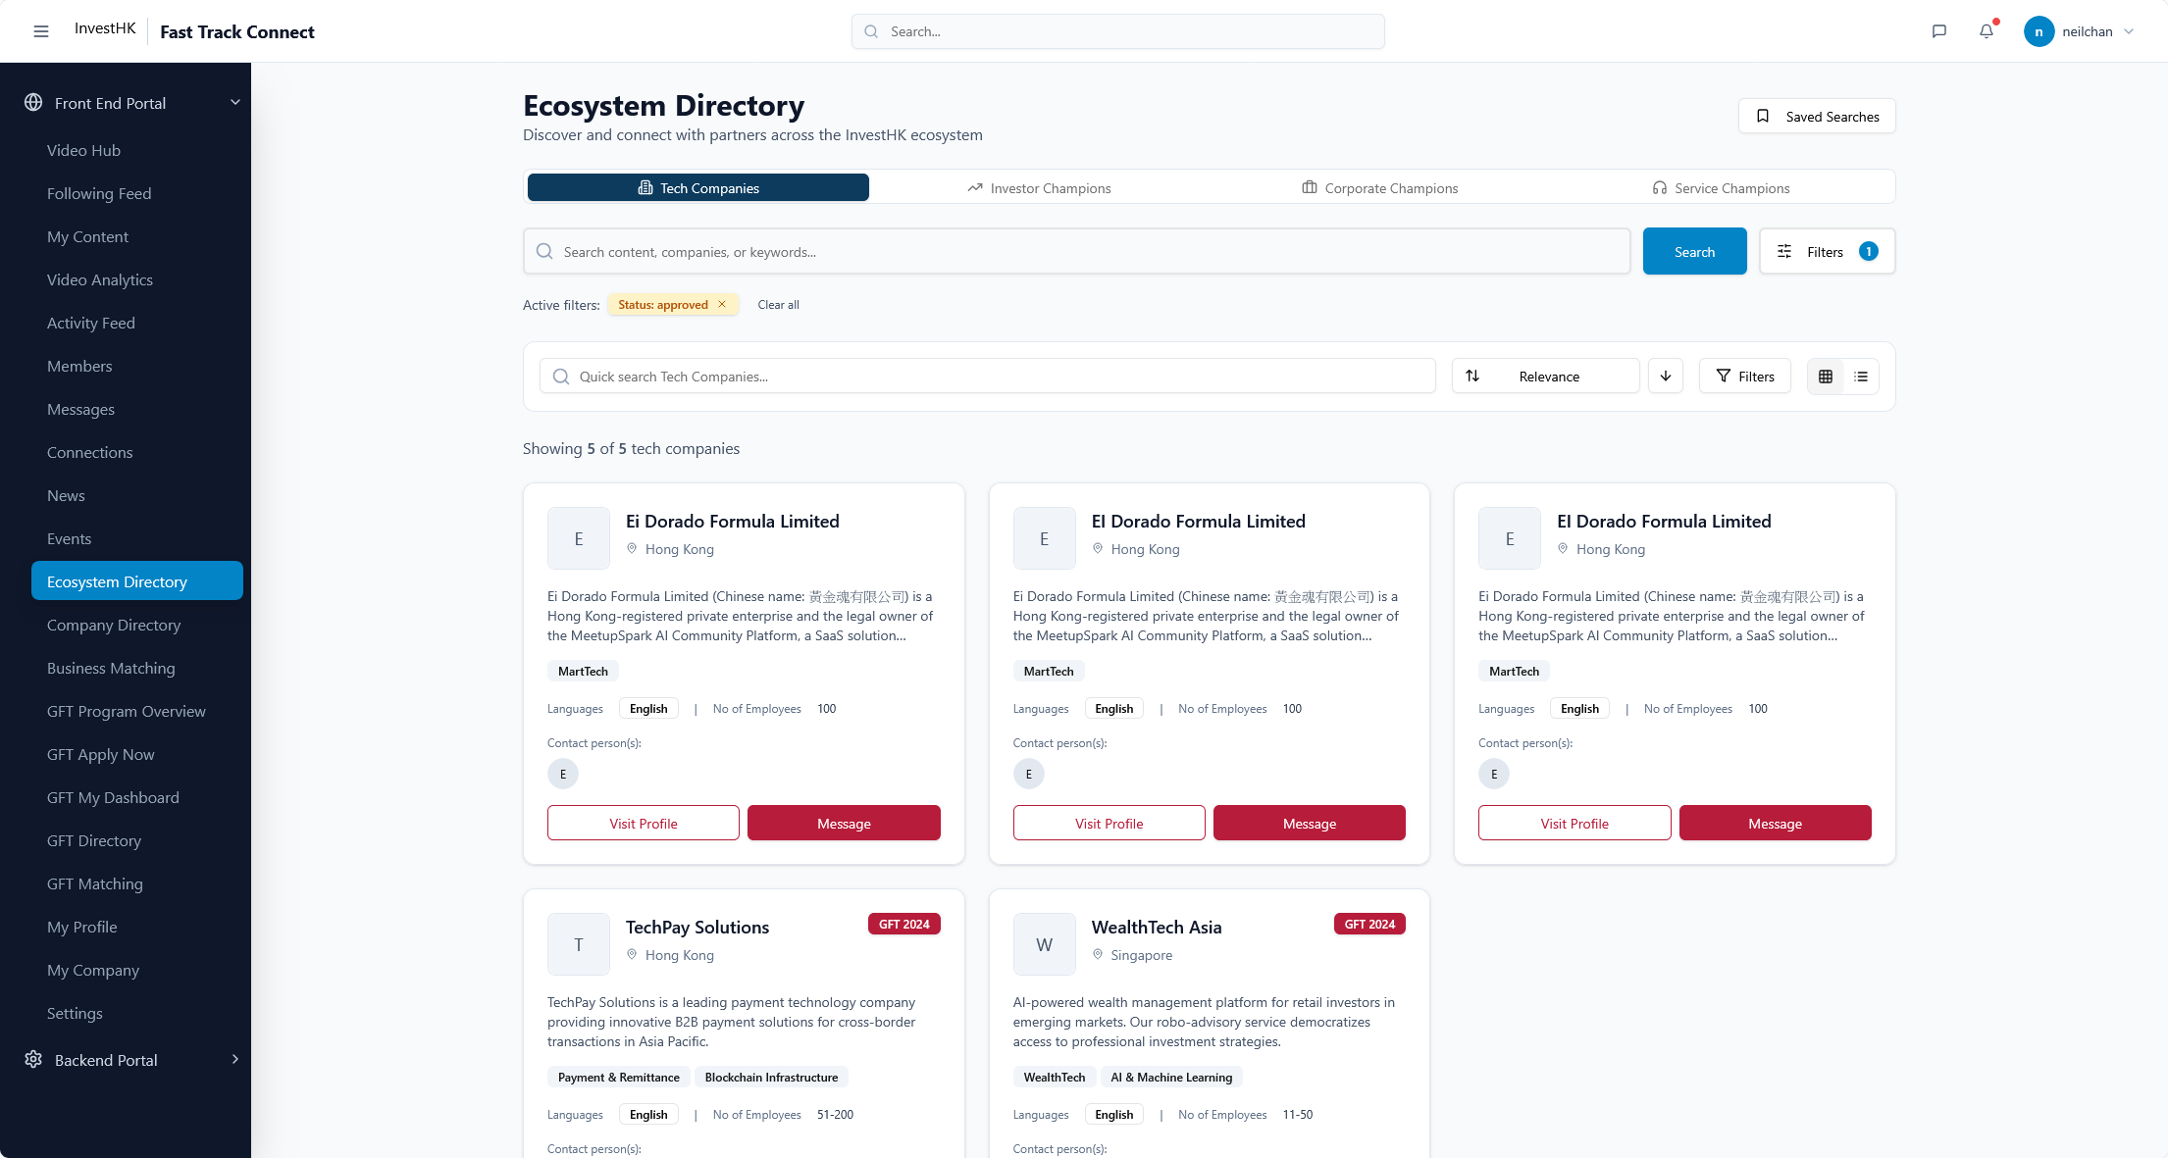

Slide 17
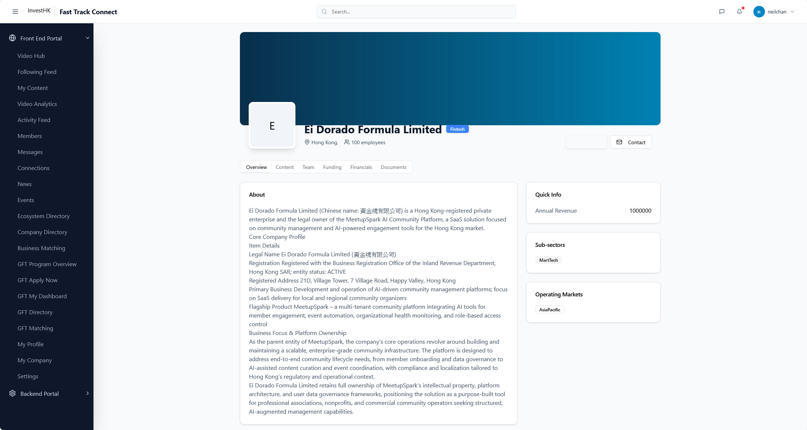
Contact – record and jump to email

Slide 18
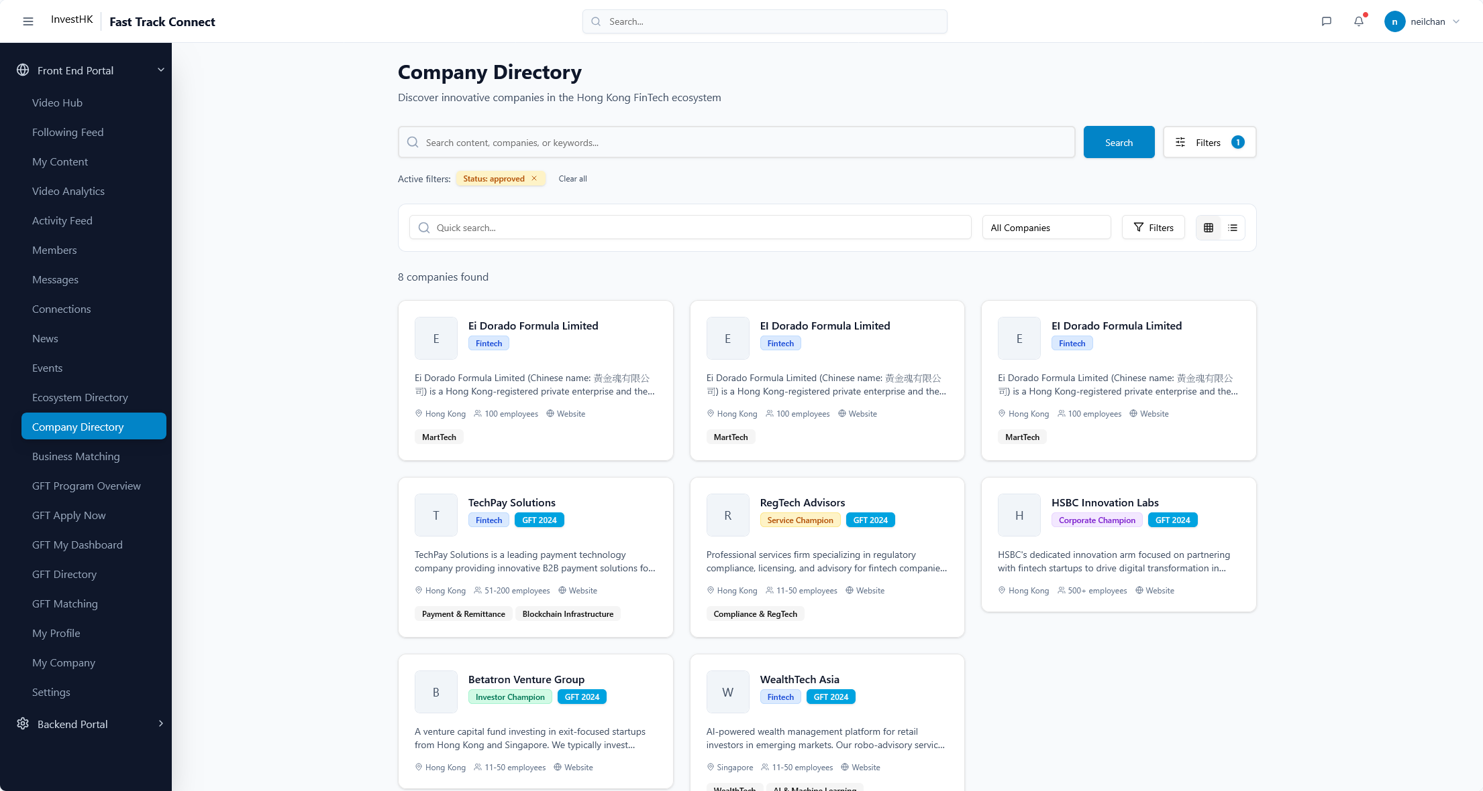

Slide 19
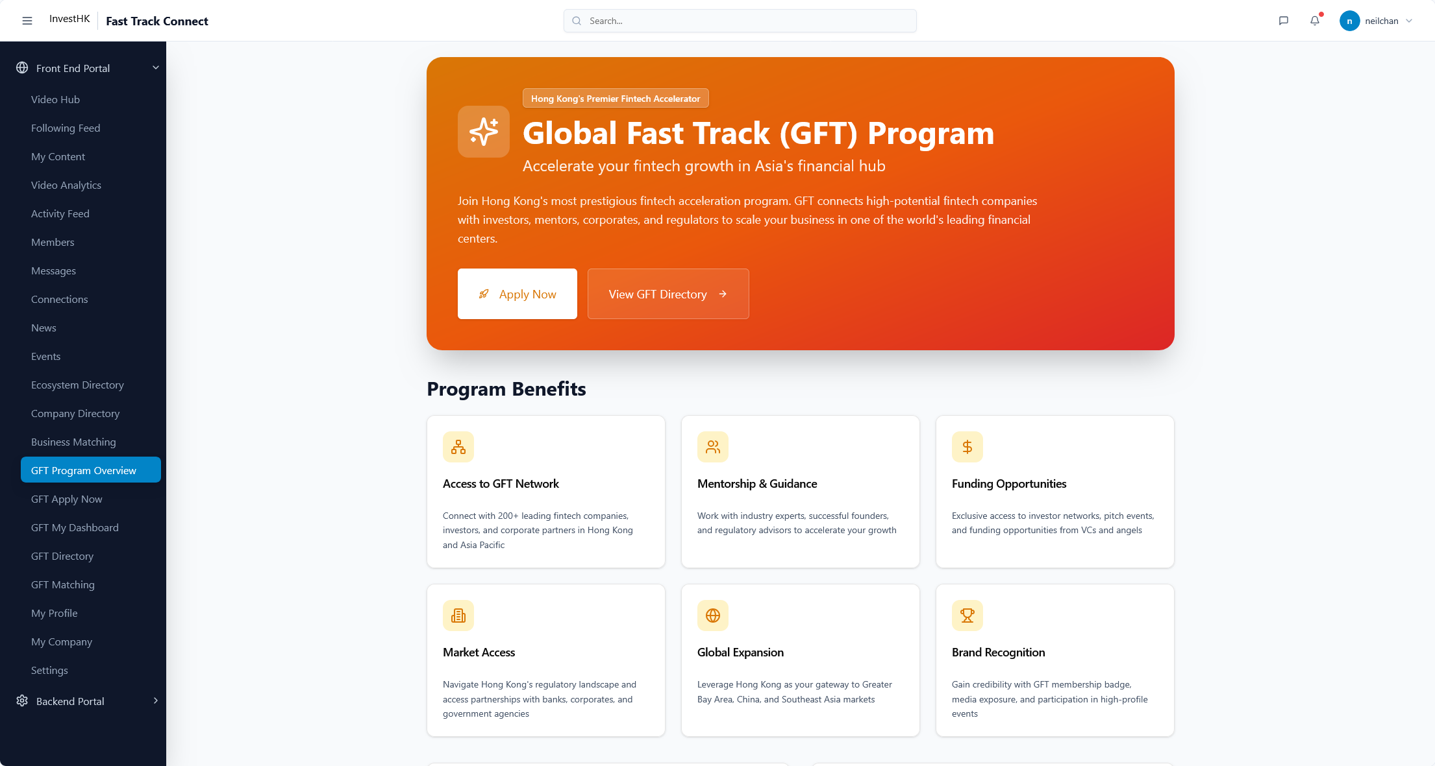

Slide 20
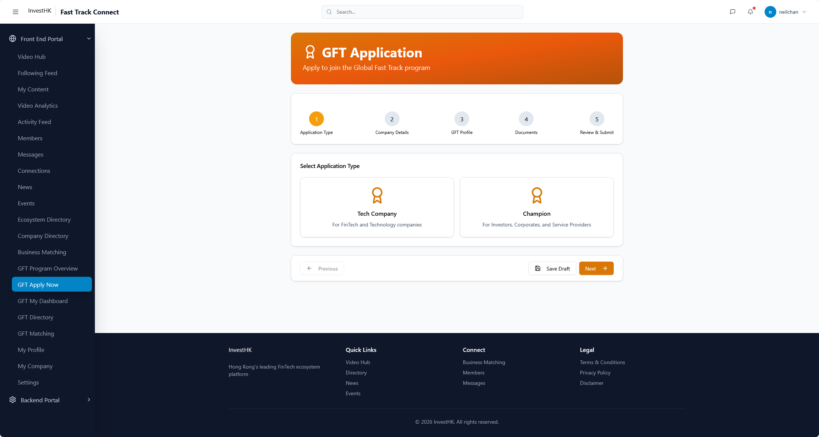

Slide 21
Company Profile Page Layout
8 Apr 2026 update

Slide 22
Data fields
Please provide the data field selection/addition for the platform. It should all accessible from the company profile page.
Deadline

Slide 23
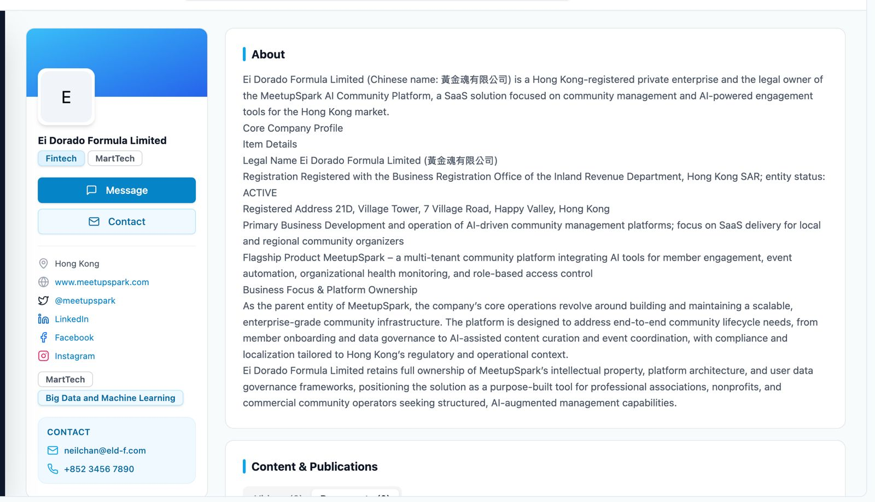
Leverage existing data fields add these info
Location
Company Website
Company Social links
Category /Tagging
Company Contact info, click email and will trigger email (mailto:)
Leverage existing data fields add these info
Company self intro

Slide 24
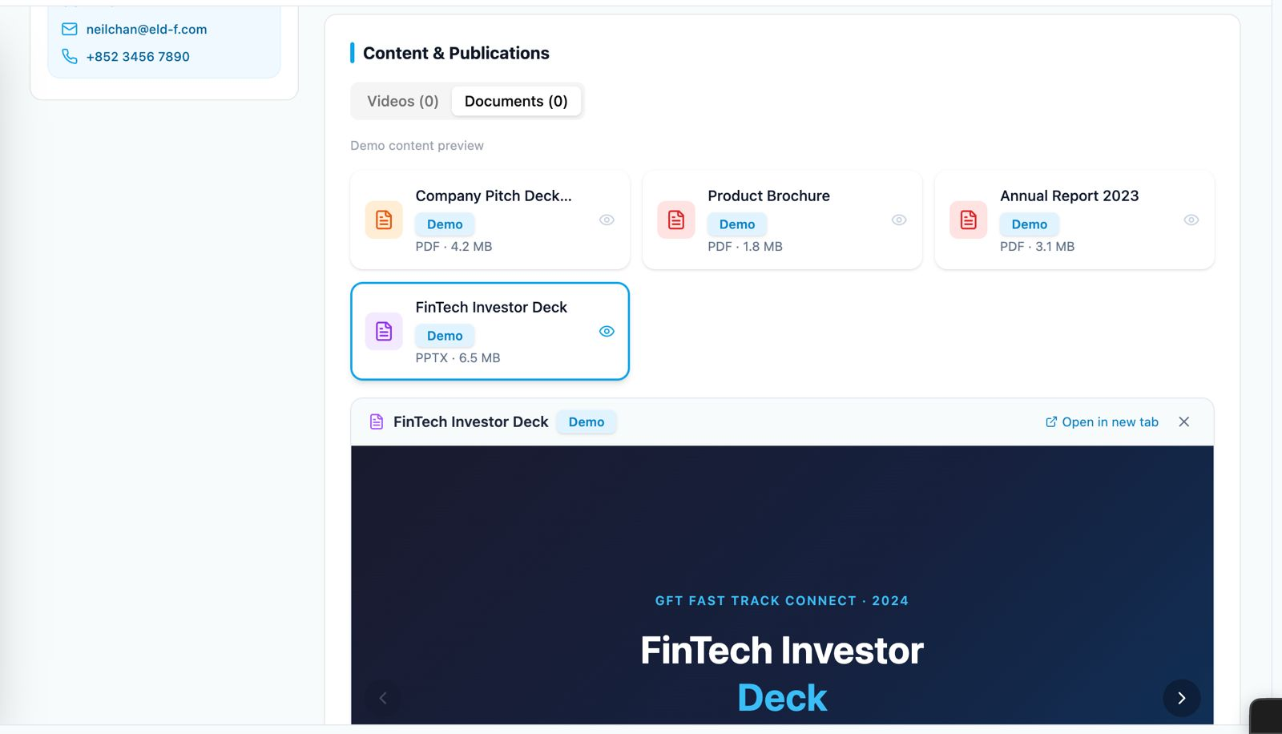
File section and display below

Slide 25
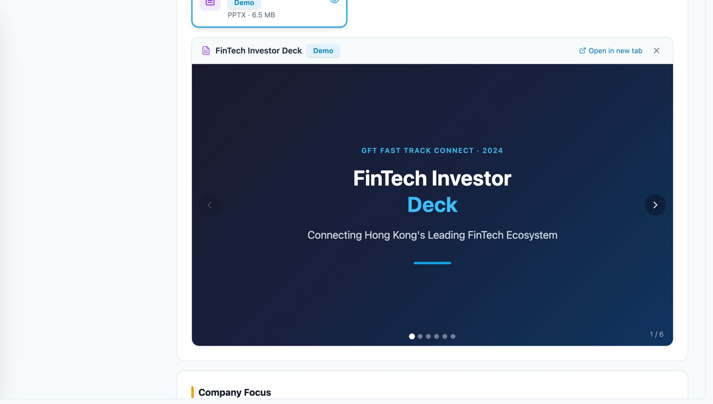
File Preview section

Slide 26
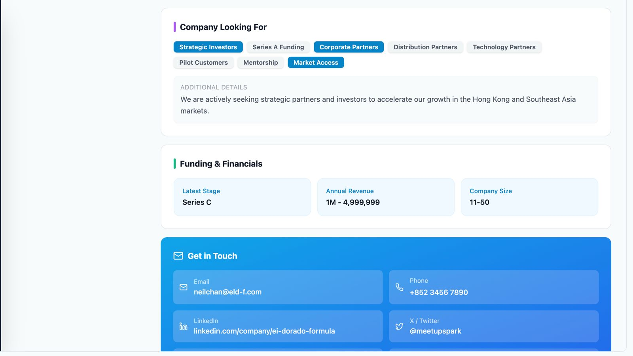
Selection of tags
Fill in free text
Existing data fields

Slide 27
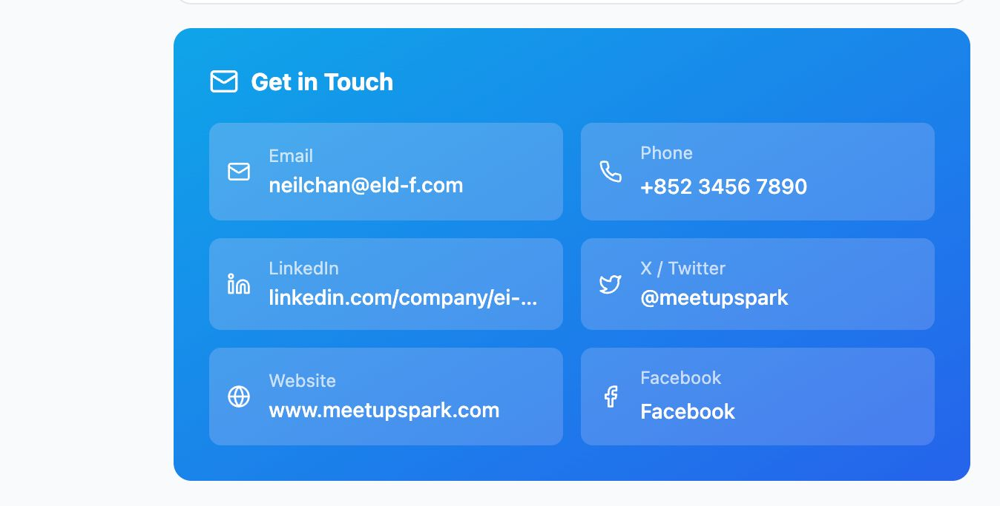
Contact and Social

